Slide 1


Rural Road Management System
https://prdroads.wb.gov.in
Developed by EMDEE Digitronics Pvt. Ltd.

Slide 2
About the Project
A Road Management System is a comprehensive framework designed to manage and maintains road infrastructure efficiently.
The Road Management System is the primary means for defining and monitoring the state, maintaining an inventory of the roads features, conditions, and characteristics, and providing decision-makers with the information necessary for funding, project design, and maintenance programming.
The development of this system to help road create and maintains from all district and State is most often the consequence of the awareness of severe gaps concerning basic data characterizing the network, structure and deterioration indicators, roughness indices, etc.
After collecting all data from panchayat related to Road Management System are directly send to State level to process the data in Road Management System web portal.

Slide 3
Benefit of this Application
Road approval process, tendering, work order, inspection up to complete the road, quality monitoring from state level – everything is managed by this application
Approval process will be done in short time
Upper level can monitor the status
Road can be identified by geo-tagging picture and information
Tendering, Re-tendering, Work Order with document and information are available in upper level
Multiple schemes/fund can be managed
User can be managed role wise and division wise
Various management reports are available – like division wise, agency wise, progress wise etc.
Reports are standard format and available to download in excel
Call log is available for support – anyone can log the call and support team can resolve and reply back to customer

Slide 4
Work Process - I
Gram Panchayat send survey reports from roads details to the State Authority.
This details is processed by this portal in the following steps :-
  Only Admin/State entry the road details.
  After road entry complete road details show the agency login side
  There are five types of agency
      ZP(Zilla Parishad)
      BLOCK
      WBSRDA(West Bengal State Rural Development Agency)
      MBL
      AGRO
  ZP and BLOCK forwarded the roads details to the DM(District Magistrate) for next step.
  DM(District Magistrate) checked all roads details and forwarded to SE(Superintending Engineer) for the next step.
  SRDA/MBL/AGRO forwarded roads details directly to SE(Superintending Engineer) for the next step.

Slide 5
Work Process - II
  SE(Superintending Engineer) checked roads details properly and forwarded to STATE for Approval.
  STATE checked roads details properly and give the approval.
  If any mistake, STATE returns the roads details to SE, and also SE returns to DM/SRDA/AGRO/MBL, and DM returns to ZP/BLOCK.
  After approval all agency going to tendering process.
  After tendering complete the agency going to work order process.
  Work order process complete the road work started.
  Road work started and Engineer update status on portal.

Slide 6


Architecture
DATABASE
Web Application
Web Server
APACHE
HTTPS Request
HTTPS Response
HTTPS Response
HTTPS Request
Mobile Application

Slide 7
Road Approval Process
Agency
State Level
Road Master
Survey – Direct Agency
Survey – In-direct Agency
Approve
Reject
Approve
Reject
District Magistrate
Approve
State Executive Engineer
Reject
Approve
Reject
State Admin
Is Final Approval?
Agency

Slide 8
Work Progress Flowchart
Agency
Inspection
Tender
No
Yes
Work Order
Contractor
Pathashree Engineer/JE
Monitoring
Work Progress
Complete

Slide 9
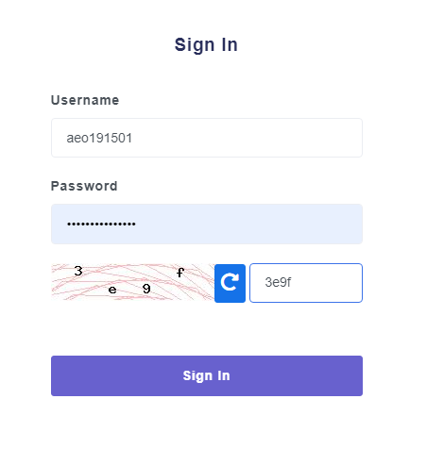
Login
Admin/State level
Agency
District level
All engineer – assistant, junior, executive, pathashree etc.
Support login
Several types of login here

Slide 10
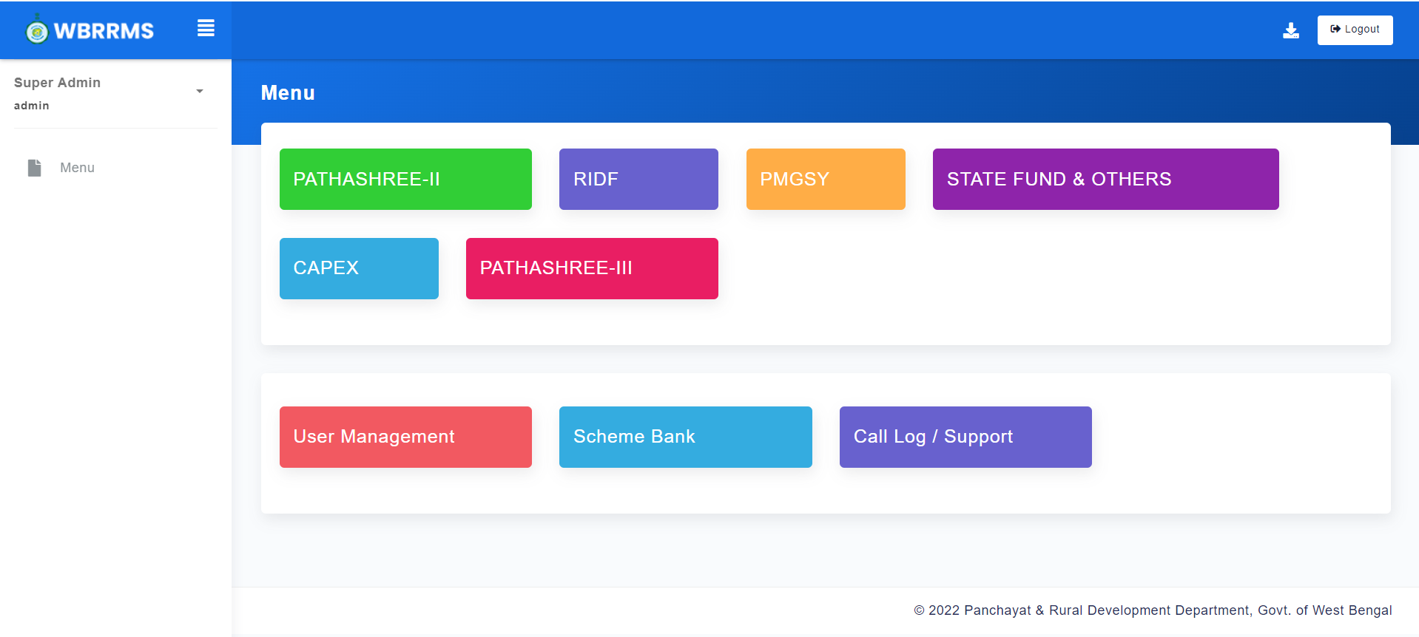
Admin Menu

Slide 11
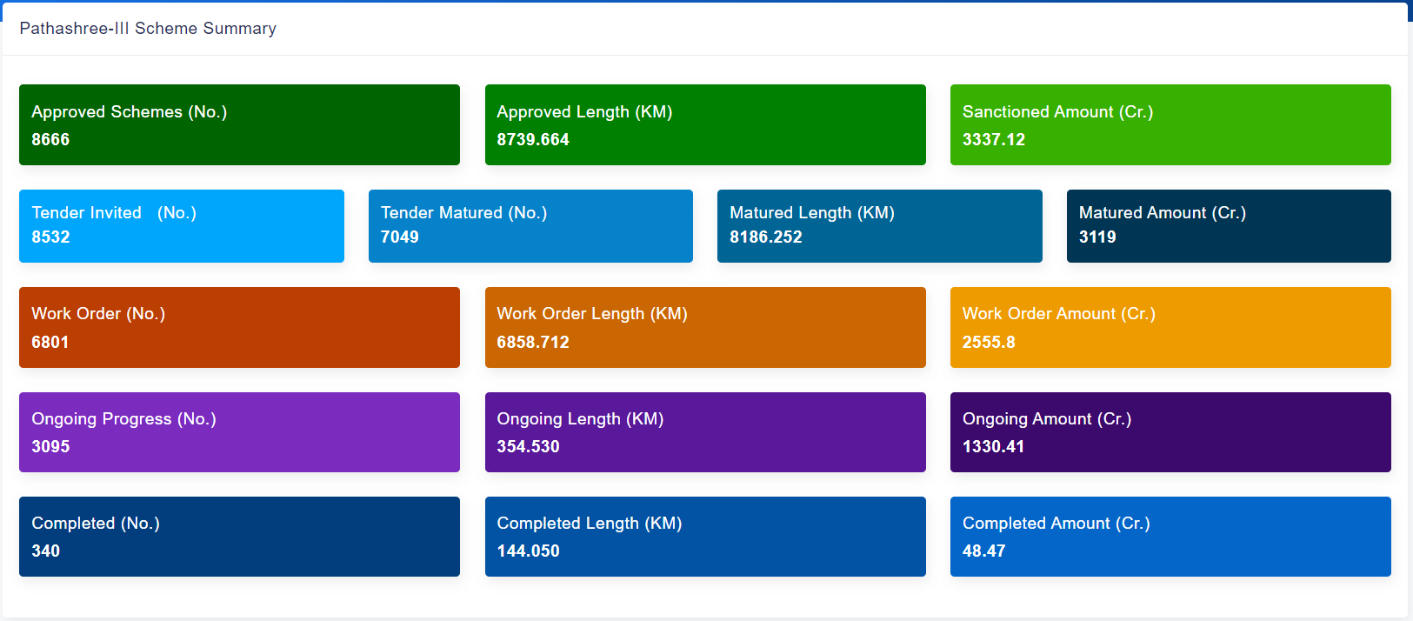
Scheme Overview
Scheme Summary

Slide 12
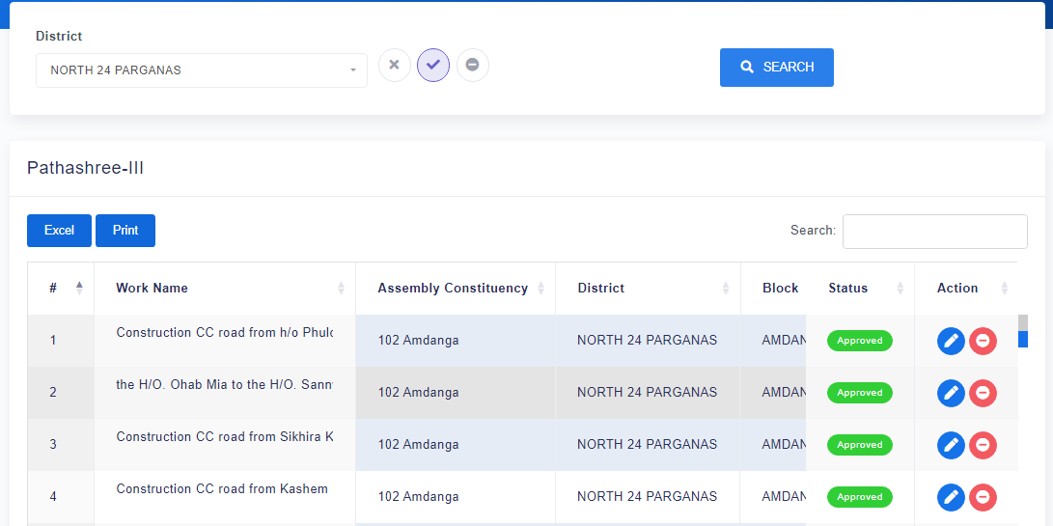
Road Master Status
Approve
Not Approve
Not Implemented

Slide 13
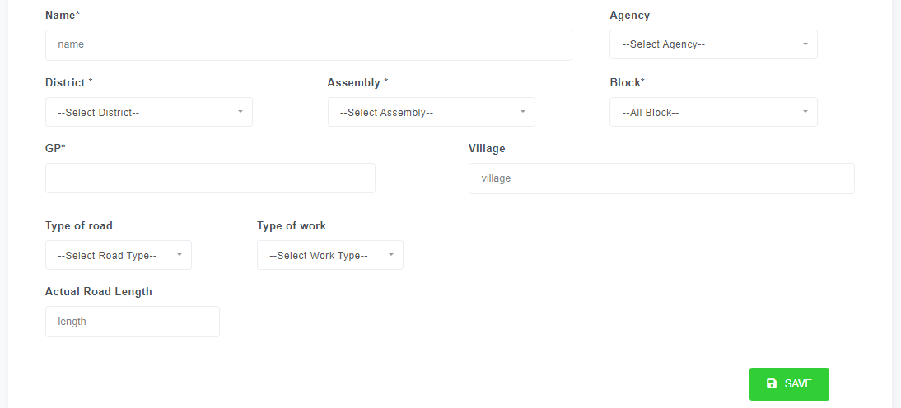
Road Master Entry

Slide 14
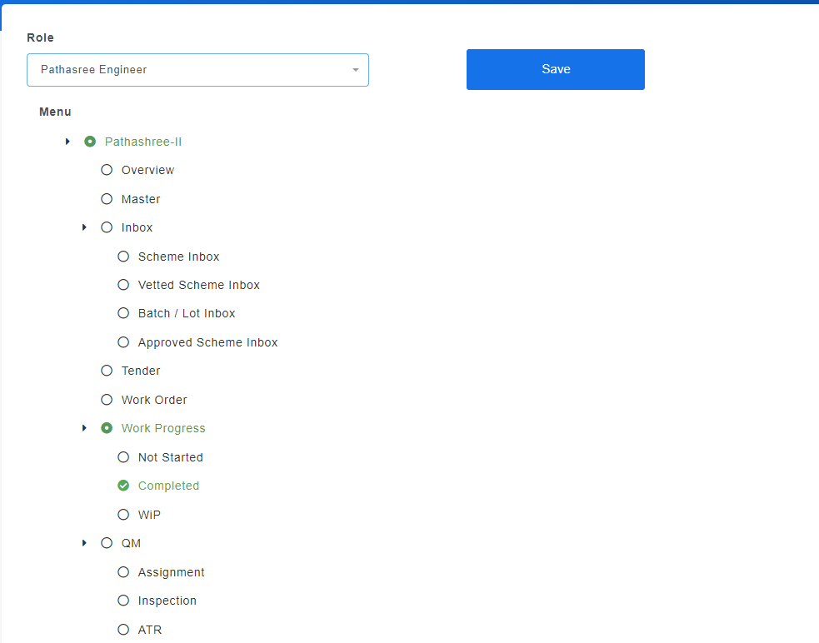
User Management

Slide 15
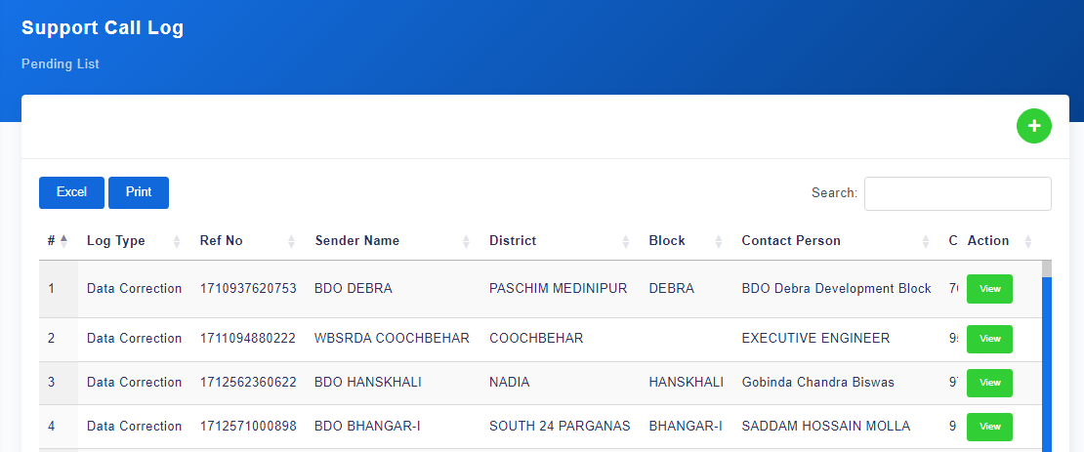
Call Log - Support

Slide 16
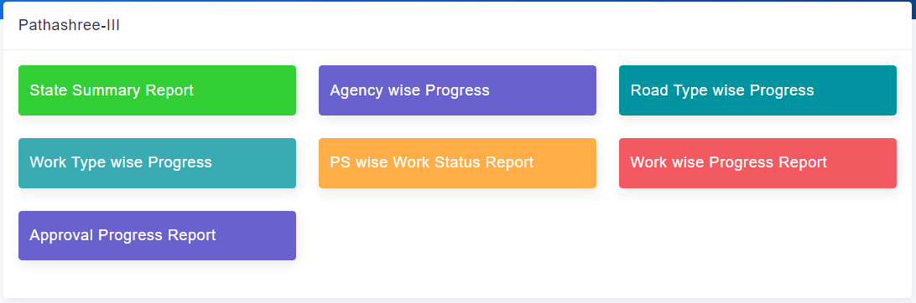
Report Overview

Slide 17
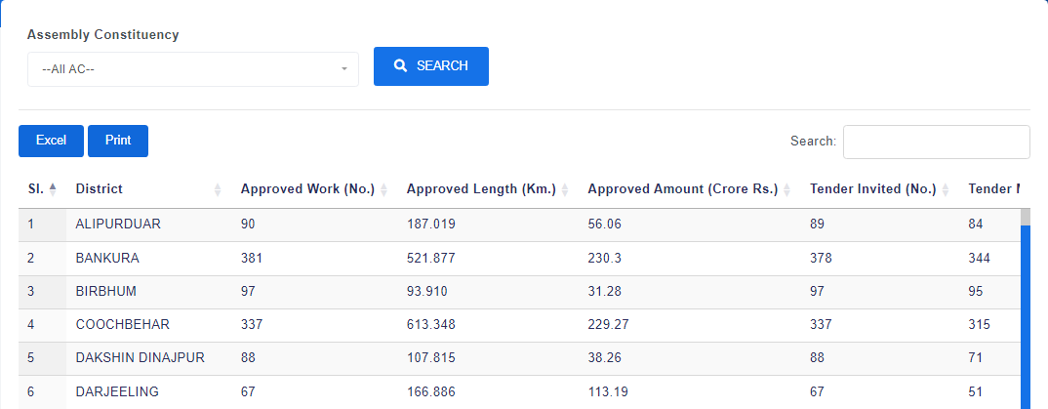
State Summary Report

Slide 18
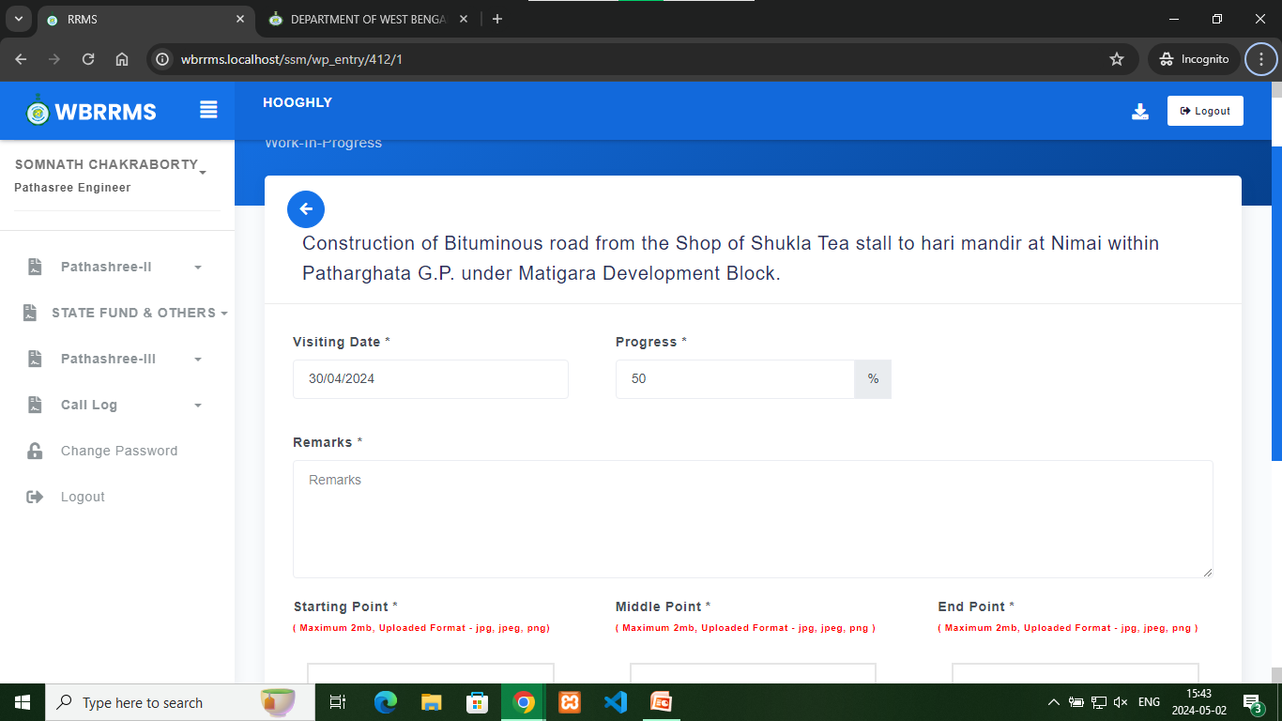
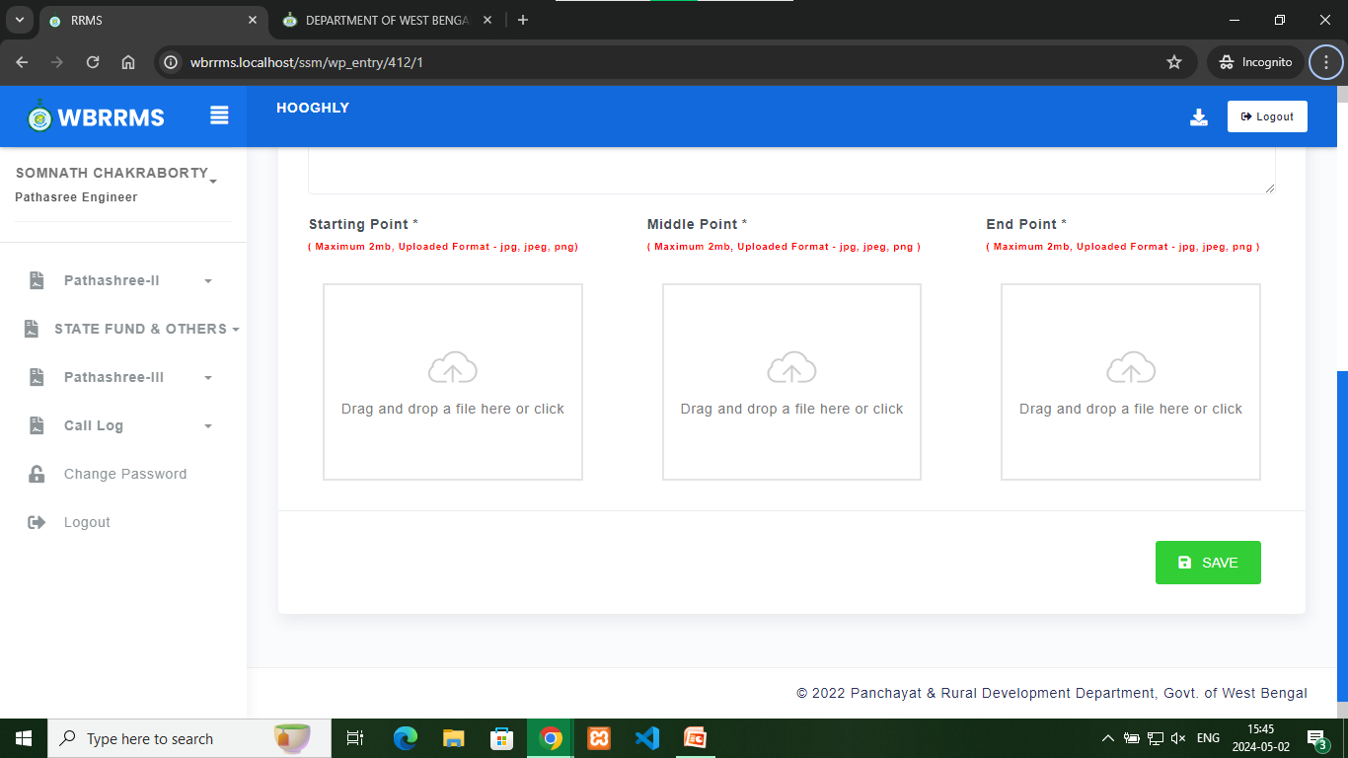
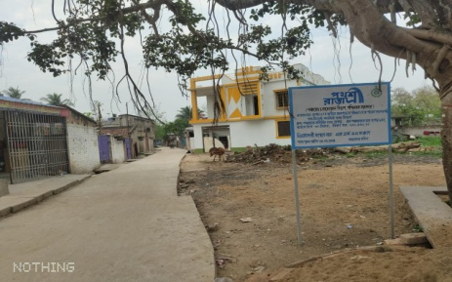
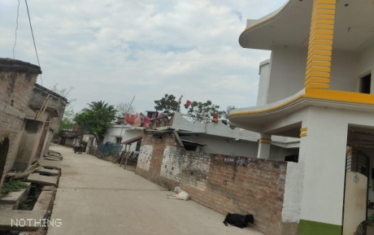
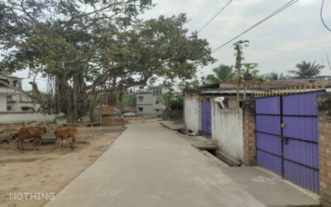
Inspection
30/04/2024
50
Road work in progress

Slide 19
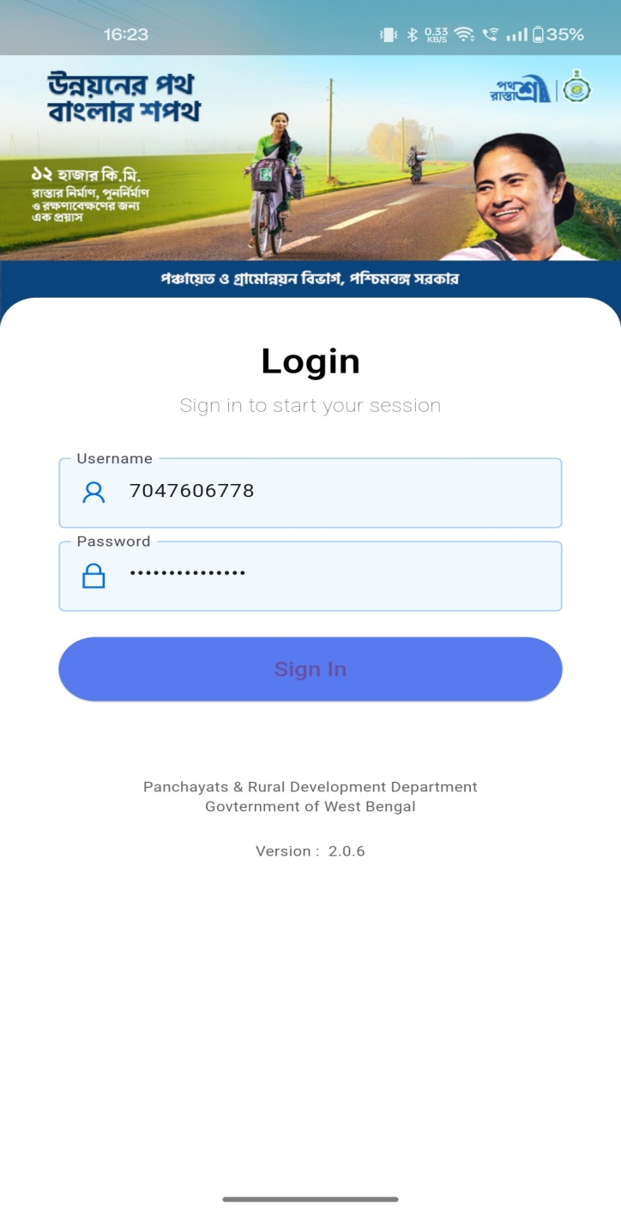
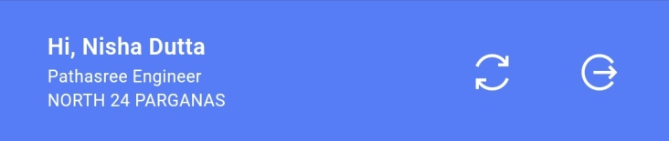
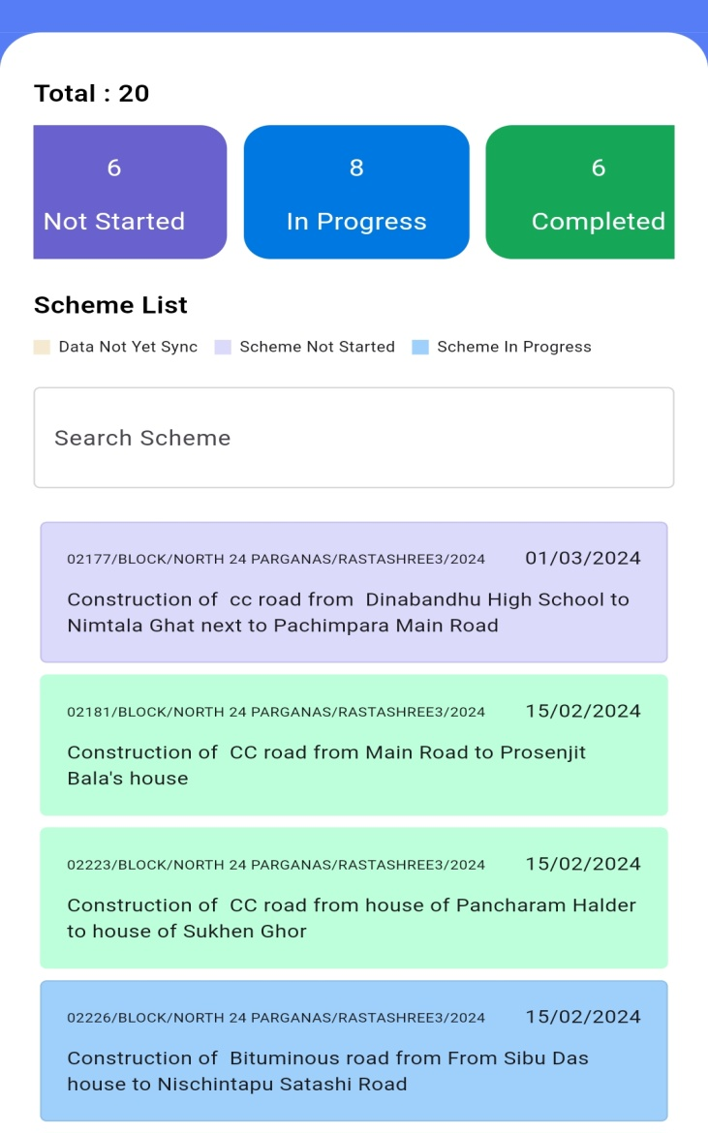
Mobile Applications
The engineer can update the progress of road of assigned roads only
User
9002978399

Slide 20
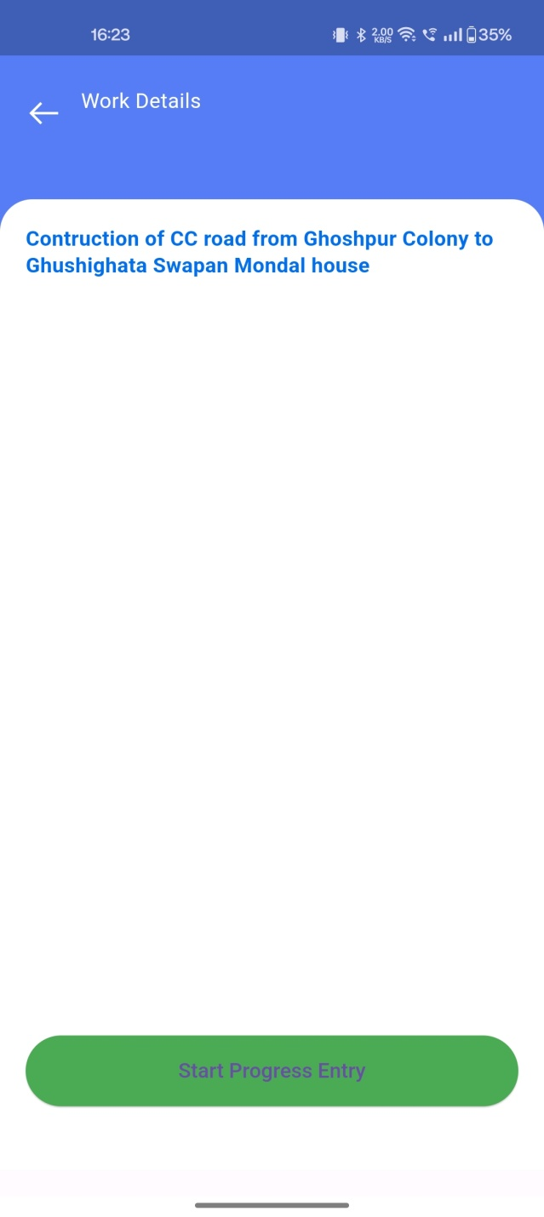
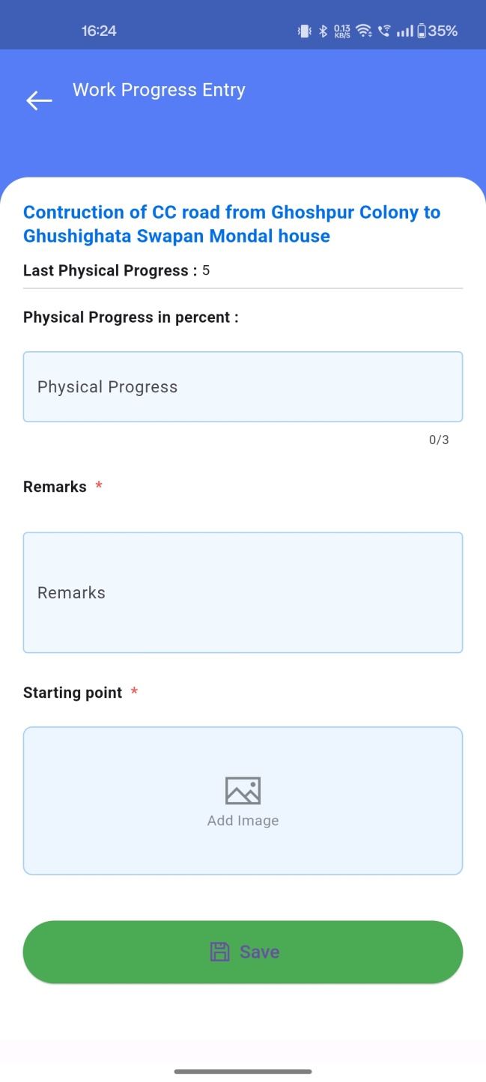
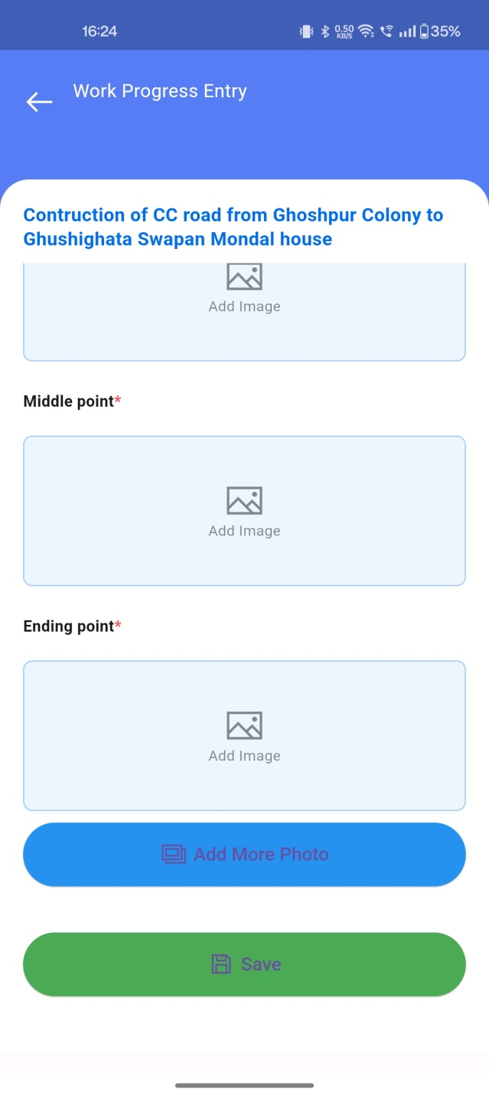
Mobile Applications

Slide 21

THANK YOU

